Slide 1
Multiplayer Internet Chess
Al Aloqla, Taylor Bishop, Tyler George

Slide 2
Design
User will be asked to enter a username
User can create a new game
User can join an existing game from a list of players who have already created a game and are awaiting a second player

Slide 3
Implementation
Using Node.js with Express and Socket.io on an EC2 instance
- Javascript for both the frontend and backend
Implemented using Strategy design pattern
No persistent data

Slide 4
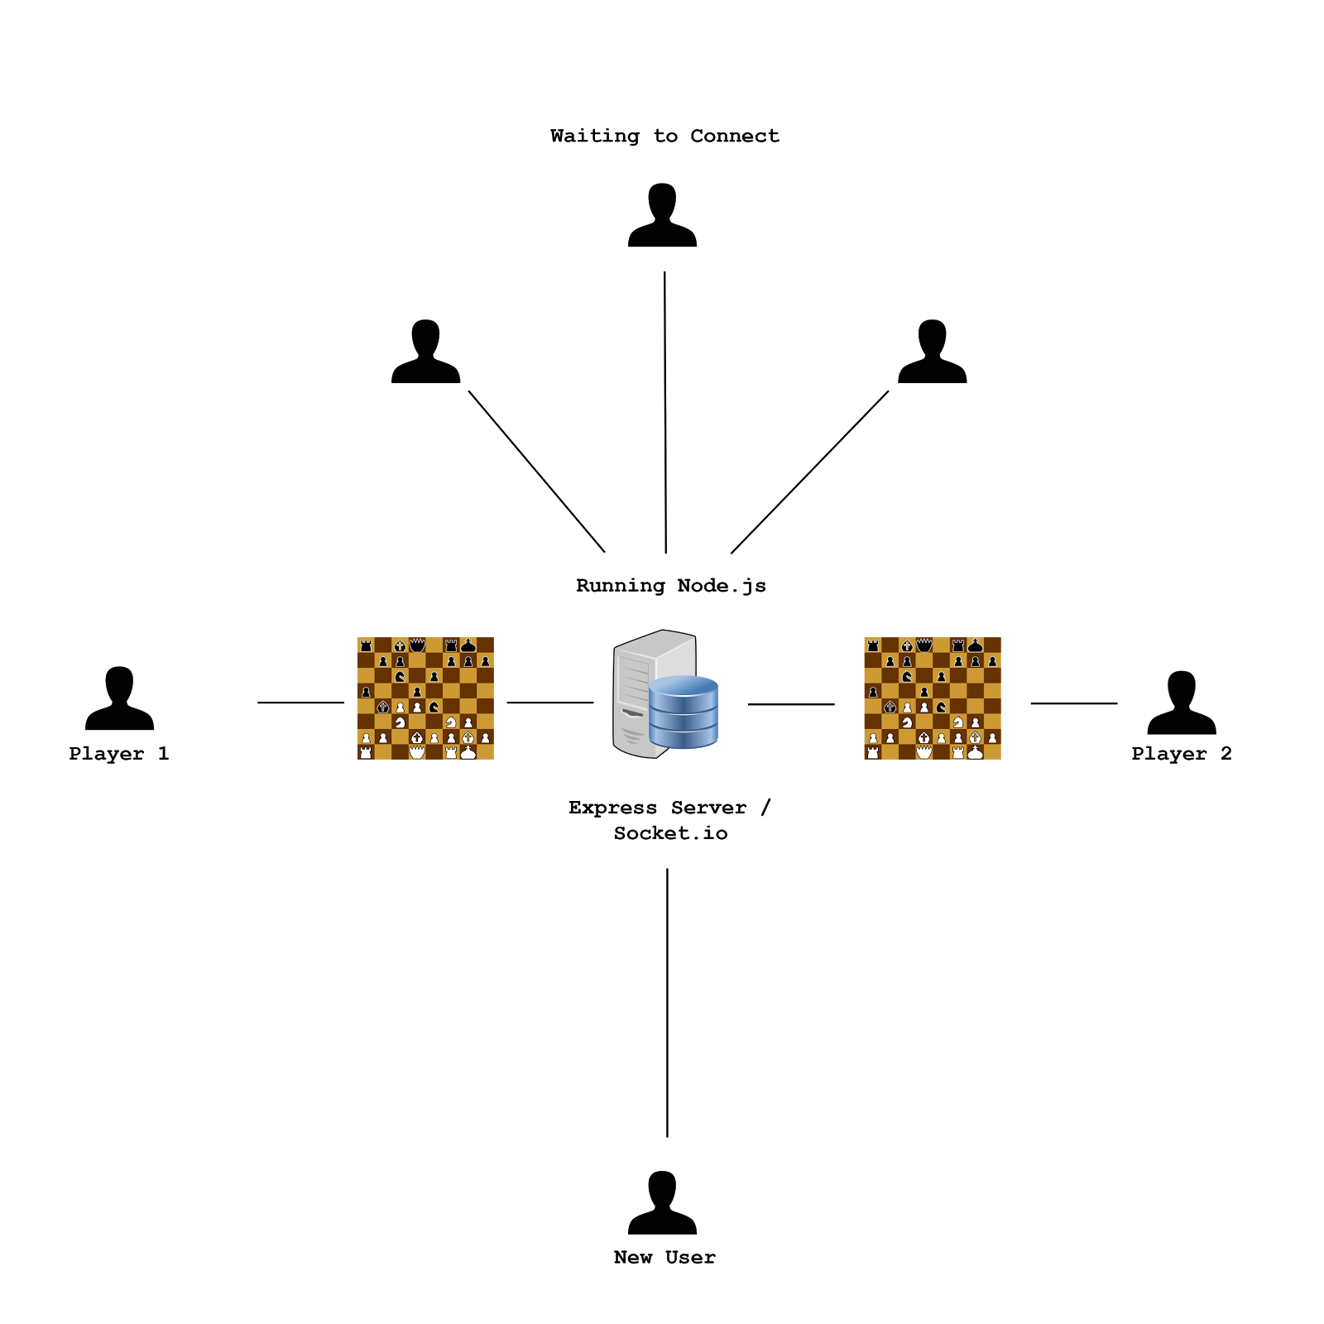
Architectural Diagram

